Slide 1

Gabriel Alves
Scott Boxberger
Erik Figge
Kobe Bryant. He Shoots. He Scores?

Slide 2
Is Kobe Clutch?

Slide 3

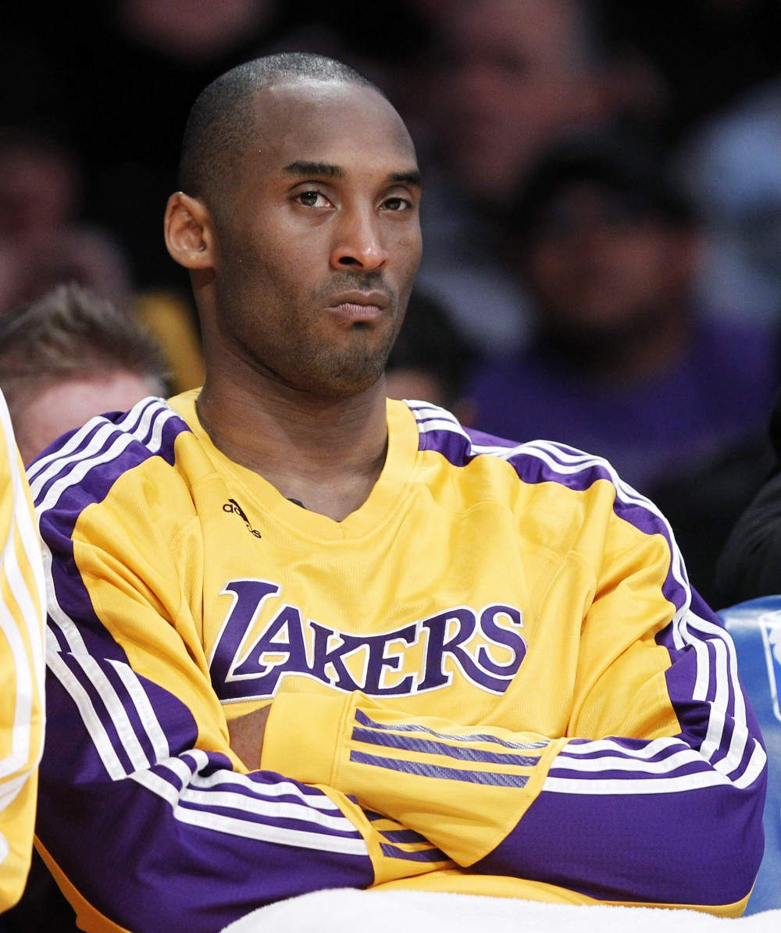

Slide 4
Does kobe shoot a lot?

Slide 5

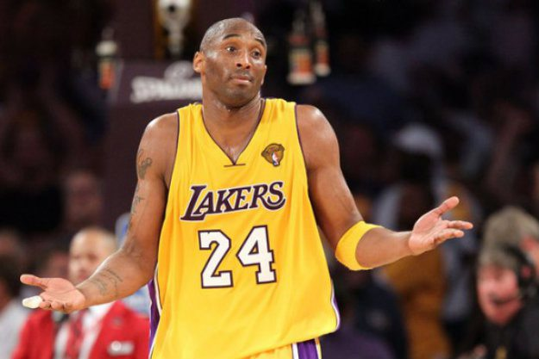

Slide 6
The end
Questions?

Slide 7

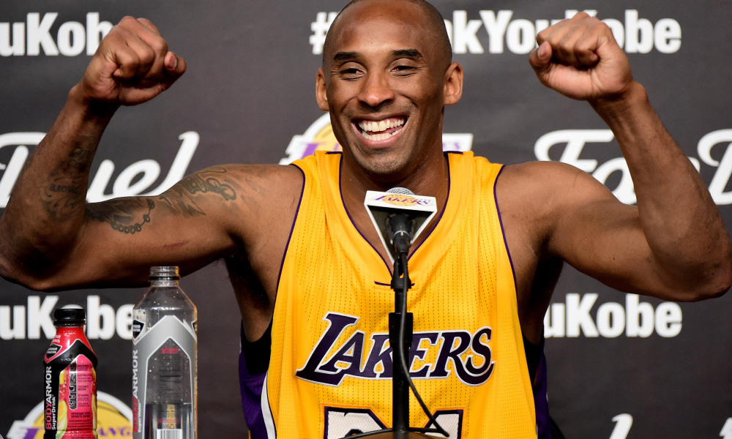
Model Results
Model Type | Parameter Comments | Accuracy | Kaggle Score
Deep Neural Network | Two hidden layers (100 nodes each) Activation: relu, softmax | 0.682645914 | 7.11766
Random Forest | n_estimators=50 max_features=sqrt | 0.631284047 | 1.98653
Gradient Boosting | max_depth: 4 max_features: log2 min_samples_leaf: 4 min_samples_split: 7 n_estimators: 50 | 0.679495661 | 0.90566
Logistic Regression | C=1.0 class_weight=None dual=False fit_intercept=True intercept_scaling=1 max_iter=100 multi_class=ovr penalty=l2 solver=liblinear tol=0.0001 | 0.682645914 | 0.97507
Average (all 4) | unweighted | N/A | 0.97544
Average (all except NN) | unweighted | N/A | 0.96848
Average (GB & LR) | unweighted | N/A | 0.93108
Weighted Average (GB & LR) | 80-20 | N/A | 0.91434
Weighted Average (GB & LR) | 90-10 | N/A | 0.90977
Weighted Average (GB & LR) | 95-5 | N/A | 0.90766
Weighted Average (GB & LR) | 99-1 | N/A | 0.90605

Slide 8
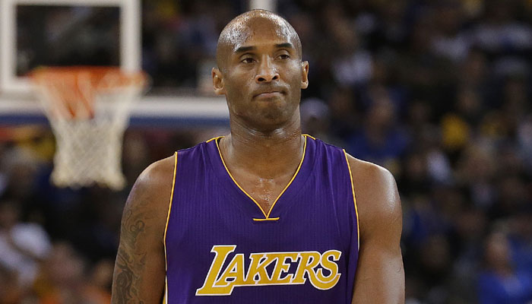
Competition results
Kaggle Top Score | 0.56528
Our Best Result (Gradient Boosting) | 0.90566
Rank | 981
Total Participants (Closed) | 1117

